Slide 1
Forecasting the Spread of Toxicity on Twitter
AATMAN VAIDYA
SCHOOL OF ENGINEERING AND APPLIED SCIENCE
AHMEDABAD UNIVERSITY
SEEMA NAGAR
IBM INDIA RESEARCH LAB
​
AMIT A. NANAVATI
SCHOOL OF ENGINEERING AND APPLIED SCIENCE
AHMEDABAD UNIVERSITY

Slide 2
Introduction
UNDERSTANDING THE SPREAD OF HATE IS CRUCIAL
Hate Speech online has lead to real-world attrocites
Rohingya genocide in Myanmar [1]
Pittsburgh synagogue shooting [2]
WHAT IS "TOXICITY"
Toxicity is defined as a “rude, disrespectful, unreasonable comment that is likely to make someone leave a conversation"
TOXICITY AS A FORECASTING PROBLEM
[1] - https://www.reuters.com/investigates/special-report/myanmar-facebook-hate
[2] - https://www.nytimes.com/2018/10/27/us/active-shooter-pittsburgh-synagogue-shooting.html

Slide 3
QUESTIONS WE ARE INTERESTED IN EXPLORING
Is it possible to forecast the toxicity of the network while ignoring the structure of the network?
Is it possible to forecast at different levels of granularity in the network ? Community level, User level etc
When the structure is taken into account, does this aid predictability?
How complex is the phenomenon – can statistical models forecast it? or we need deep learning techniques?

Slide 4
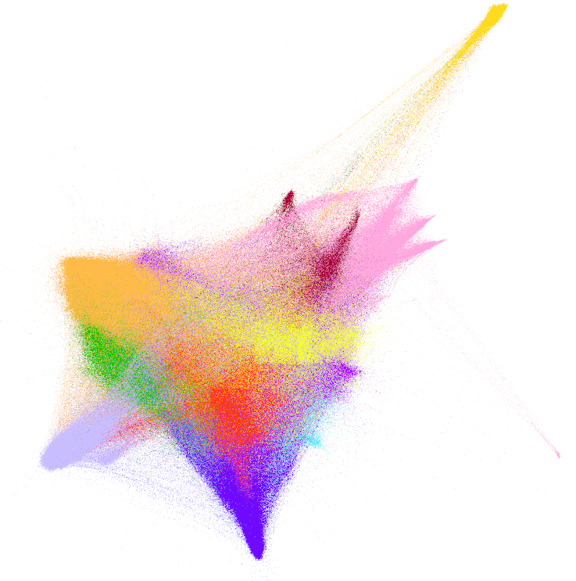
Dataset Description and Properties
WE USE THE DATASET PUBLISHED BY RIBEIRO ET AL. [1]
Contains 100,386 users and 19.58 million tweets.
Majority tweets are from January 2017 to October 2017.
We use Perspective API [2] to assign a toxicity score to each tweet between [0-1].
DIRECTED RETWEET GRAPH
The dataset also has a directed retweet graph G = (V,E), where each node u ∈ V represents a Twitter user.
Each edge (u, v) ∈ E represents a retweet in the network
[1] - M. H. Ribeiro, P. H. Calais, Y. A. Santos, V. A. Almeida, and W. Meira Jr, “” like sheep among wolves”: Characterizing hateful users on twitter,” arXiv preprint arXiv:1801.00317, 2017.
[2] - https://perspectiveapi.com/

Slide 5
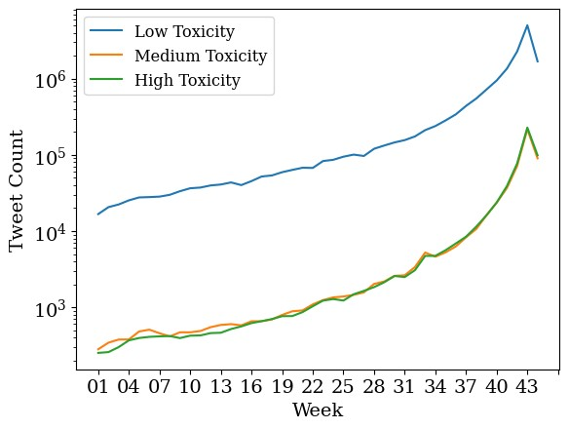
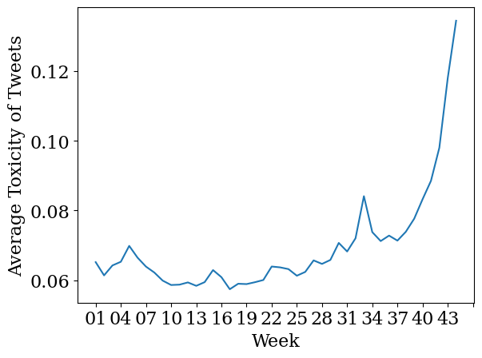
Number of Tweets for Toxicity Range across weeks
Average Toxicity across weeks

Slide 6
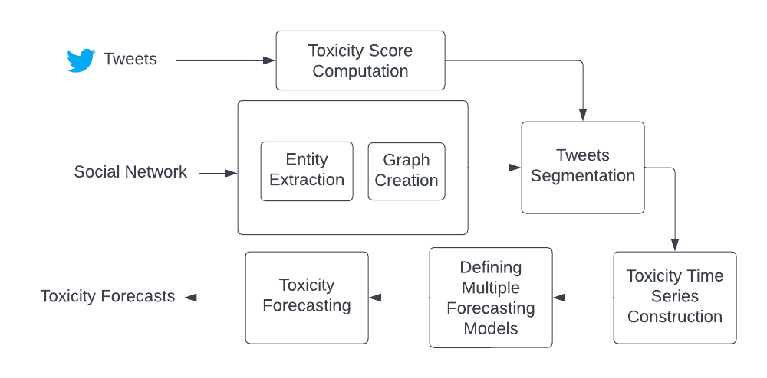
Approach

Slide 7
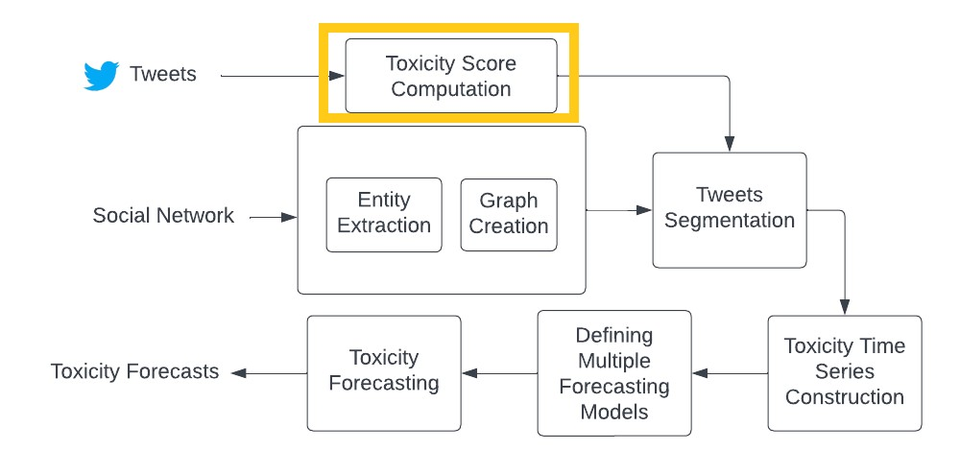
Perspective API

Slide 8
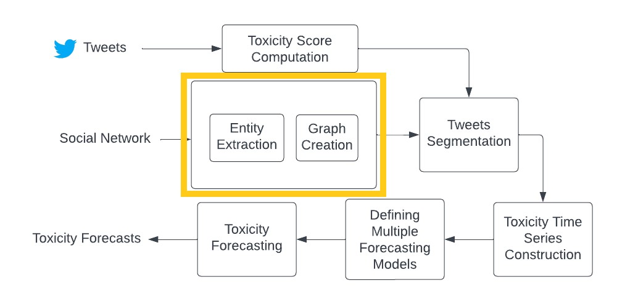

Slide 9
Defining Levels for Toxicity Spread Modelling
1 - ENTIRE GRAPH AS ONE ENTITY
The entire social network is treated as a singular entity.
2 - COMMUNITIES AS ENTITIES
Partition the entire social graph into non-overlapping communities.
3 - NEIGHBORHOODS AS ENTITIES
Neighbourhoods of most influential users.

Slide 10
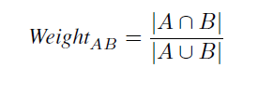
DEFINING RELATIONSHIPS AMONG THE ENTITIES
1 - OVERLAP OF USERS IN TWO ENTITIES
Weighted edges between two entities based on the number of overlapping users.
Weight = common users between two entities / total number of users in the two entities

Slide 11
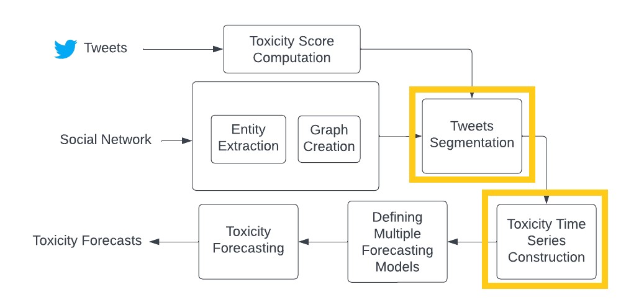

Slide 12
Formulation of Spreading Modeling as a Time Series Forecasting Problem
TOXICITY TIMESERIES CONSTRUCTION FOR EACH ENTITY
Toxicity level at a time segment = Average toxicity value of tweets associated with an entity in that time segment
TOXICITY FORECASTING APPROACHES
Variant 1 - Univariate Forecasting
Variant 2 - Forecasting with Explicit Relationships
Variant 3 - Multivariate Forecasting

Slide 13
Setting up the Experiments
PARAMETERS FOR CREATING TOXICITY TIMESERIES
Time segment - "Hour"
Total time segments - 7290
Communities as entities
We find communities by using the Louvain Community Detection Algorithm [1]
Neighbourhoods as entities
We identify the most influential users using PageRank [2]
[1] - V. D. Blondel, J.-L. Guillaume, R. Lambiotte, and E. Lefebvre, “Fast unfolding of communities in large networks,” Journal of statistical mechanics: theory and experiment, vol. 2008, no. 10, p. P10008, 2008.
[2] - Page, L., Brin, S., Motwani, R., & Winograd, T. (1998). The pagerank citation ranking: Bring order to the web. Technical report, stanford University.

Slide 14
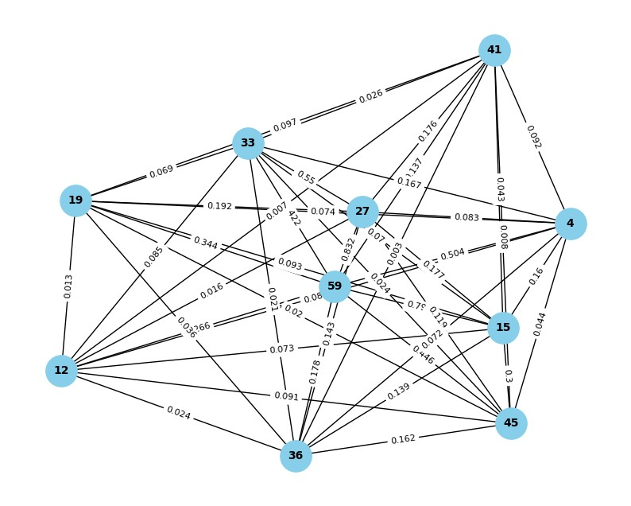
PARAMETERS FOR ENTITY GRAPH CREATION
To establish relationship between each entity
We create two weighted undirected graphs.
Graph for communities as entities
Treats each community as a node
There are 10 nodes (communities) in the graph
Graph for most influential users neighbourhood as entities
Treats each neighbourhood as a node
There are 10 nodes (neighbourhoods) in the graph
Undirected Graph of Community as an entity (Edge weight normalised)

Slide 15
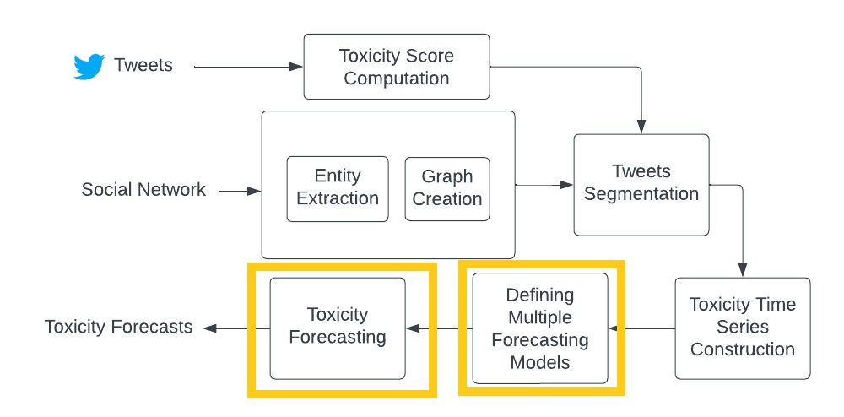

Slide 16
PARAMETERS FOR TOXICITY FORECASTING MODEL VARIANTS
Variant 1 - Univariate Forecasting
Autoregressive Integrated Moving Average (ARIMA) [1] method for forecasting.
Variant 2 - Forecasting with Explicit Relationships
Spatio-Temporal Graph Convolutional Networks (STGCN) [2]
Variant 3 - Multivariate Forecasting
In this approach, we employ five transformer-based models: Vanilla Transformer [3], FEDformer [4], Informer [5], Autoformer [6], and PatchTST [7].
We maintain a context length of 96 and a forecast length of 48.
[1] - M. S. Ahmed and A. R. Cook, Analysis of freeway traffic time-series data by using Box-Jenkins techniques, 1979, no. 722
[2] - Yu, B., Yin, H., & Zhu, Z. (2017). Spatio-temporal graph convolutional networks: A deep learning framework for traffic forecasting. arXiv preprint arXiv:1709.04875.
[3] - Vaswani, A., Shazeer, N., Parmar, N., Uszkoreit, J., Jones, L., Gomez, A. N., ... & Polosukhin, I. (2017). Attention is all you need. Advances in neural information processing systems, 30.
[4] - Zhou, T., Ma, Z., Wen, Q., Wang, X., Sun, L., & Jin, R. (2022, June). Fedformer: Frequency enhanced decomposed transformer for long-term series forecasting. In International Conference on Machine Learning (pp. 27268-27286). PMLR.
[5] - Zhou, H., Zhang, S., Peng, J., Zhang, S., Li, J., Xiong, H., & Zhang, W. (2021, May). Informer: Beyond efficient transformer for long sequence time-series forecasting. In Proceedings of the AAAI conference on artificial intelligence (Vol. 35, No. 12, pp. 11106-11115).
[6] - Chen, M., Peng, H., Fu, J., & Ling, H. (2021). Autoformer: Searching transformers for visual recognition. In Proceedings of the IEEE/CVF international conference on computer vision (pp. 12270-12280).
[7] - Nie, Y., Nguyen, N. H., Sinthong, P., & Kalagnanam, J. (2022). A time series is worth 64 words: Long-term forecasting with transformers. arXiv preprint arXiv:2211.14730.

Slide 17
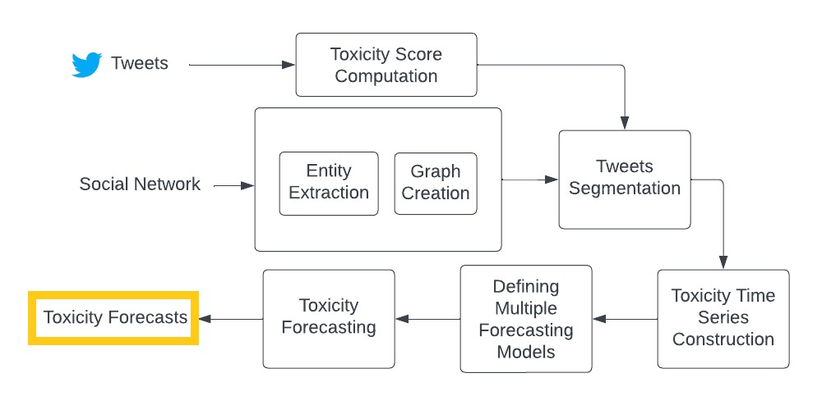

Slide 18
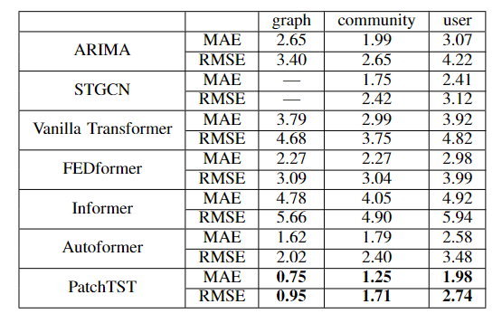
Results
PERFORMANCE AVERAGES (ALL VALUES ARE MULTIPLIED BY 100)

Slide 19
Results
PatchTST performs the best
Every explicit connection (edge) does not imply influence.
PatchTST learns the implicit associations
among the communities and neighbourhoods better than the rest of the transformers
STGCN performs the second best
Suggesting that the structure matters

Slide 20
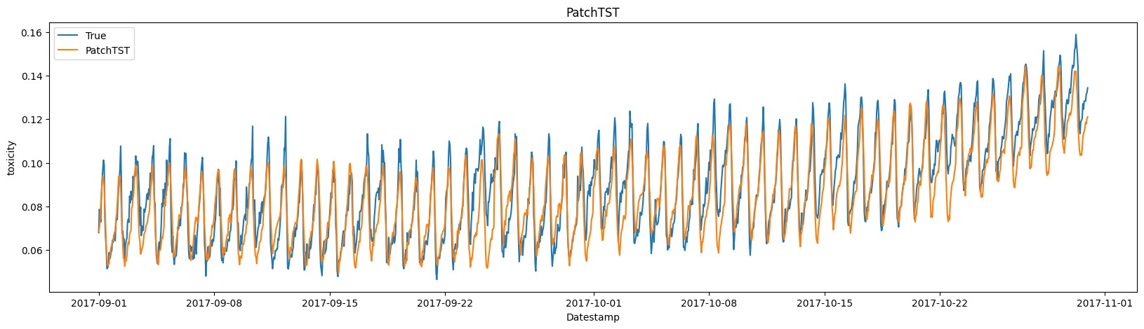
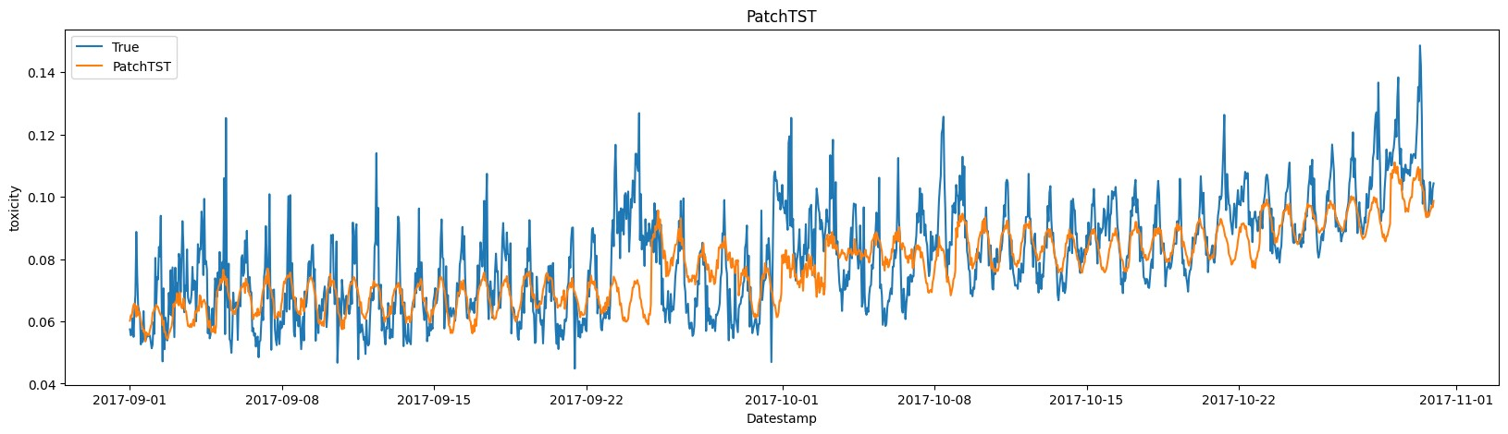
PATCH-TST RESULTS
Graph - Level
Community - Level

Slide 21
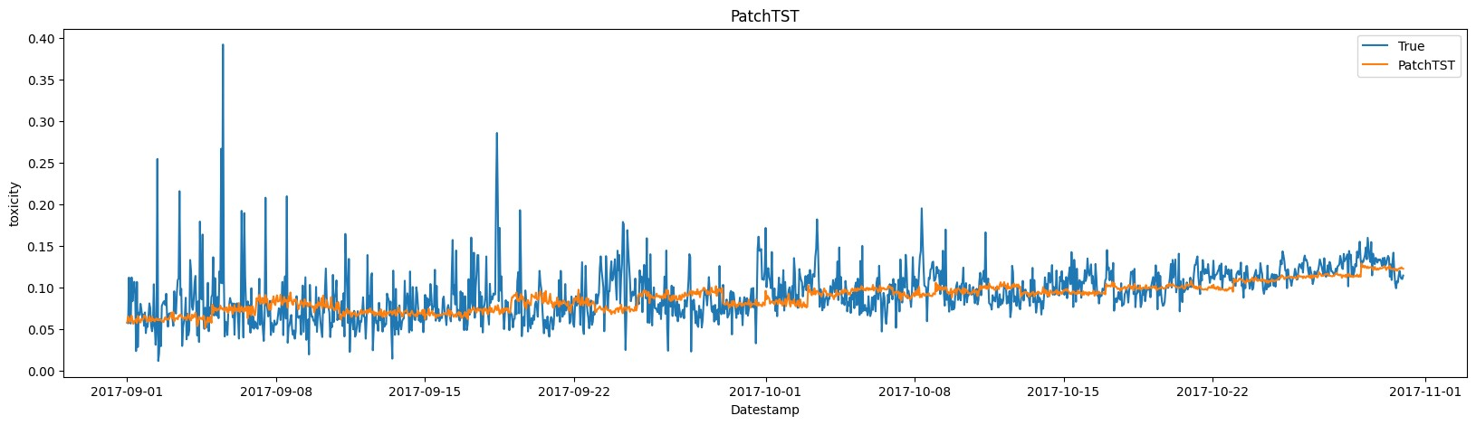
PATCH-TST RESULTS
Neighbourhood - Level

Slide 22

Industry Application
"Toxicity Forecaster" - browser extension for Twitter
See trends and patterns of toxicity of your community and neighbourhood.
Get notified when there is a spike or a drop in toxicity in your community.
Help improve the performance of the transformer by rating the accuracy and usefulness of the forecasts.
Blur content with tweets of high toxicity
Set the range of toxicities you want to see in your feed.
This plugin will help you stay informed about and safer
from toxicity on your Twitter feed

Slide 23
Conclusion
We demonstrate the viability of modelling toxicity spread as a time series forecasting problem.
Toxicity is forecastable.
Our careful definition of granularity has enabled us to address diverse scenarios where tracking toxicity
spread is useful.
The study underscores the importance of network structure in toxicity spread prediction.
Structure aids predictability
The transformer PatchTST performs the best and STGCN comes in second.
Future Work - Analyzing the output of PatchTST to reconstruct the network implied by its associations and
subsequently contrasting this with the explicit input graph presents an intriguing opportunity.

Slide 24



